Slide 1
List Implementations That Use Arrays
Chapter 5

Slide 2
Exercise key
a.
int positionOfSmallest ;
double smallest, toCompare;
int count = quizScores.getLength();
if (count > 0)
{
  positionOfSmallest = 1;
  smallest = quizScores.getEntry(1);
for (int i = 2; i <= count; i++)
{
  toCompare = quizScores.getEntry(i);
  if (toCompare < smallest)
  {
    smallest=toCompare;
    positionOfSmallest = i;
  } // end if
} // end for
quizScores.removeEntry(positionOfSmallest);
}

Slide 3
Exercise key
b.
double sum = 0.0;
double score;
double average = 0.0;
int count = quizScores.getLength();
if (count > 0)
{
  for (int i = 1; i <= count; i++)
  {
    score = quizScores.getEntry(i);
    sum += score;
  } // end for
  average = sum / count;
} // end if

Slide 4
Chapter Contents
Using a Fixed-Size Array to Implement the ADT List
  An Analogy
  The Java Implementation
Using Dynamic Array Expansion to Implement the ADT List
  Expanding an Array
  A News Implementation of a List
Using a Vector to Implement the ADT List
  A Summary of Methods in the Class Vector
The Pros and Cons of Using an Array to Implement the ADT List
  The Class ArrayList
  The Interface Serializable

Slide 5
An Analogy
Consider a classroom with 40 desks in fixed position
  Desks are wasted if less than 40 students
  Not enough desks if more than 40 students
An array is like the classroom
  Each desk an array location

Slide 6
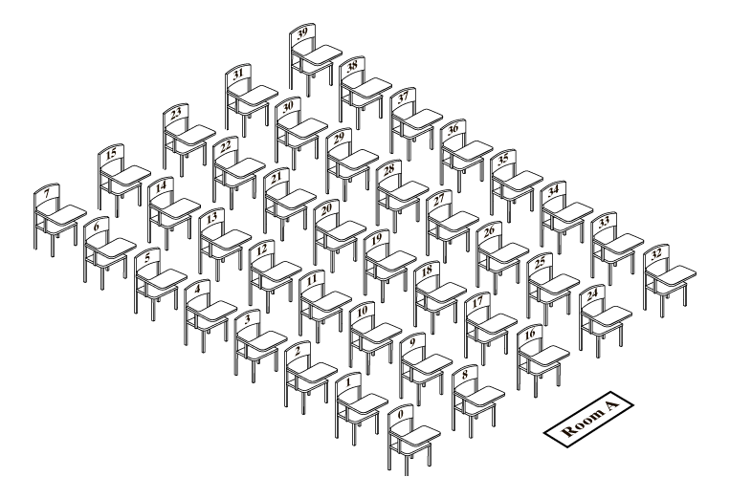
An Analogy
A classroom that contains desks in a fixed position.

Slide 7
An Analogy
Suppose we have some students in classroom in order alphabetically
We add a new student
  We desire to maintain the alphabetic order
  We must shift some students
We remove a student in the middle of the sequence
  Again, we must shift some students

Slide 8

Adding a Student
Seating a new student between two existing students: at least one other student must move

Slide 9
The Java Implementation
Private data fields for implementation of AList
  Implements interface ListInterface of Chapter 4
public class AList<T> implements ListInterface<T>
{
private T[] list; // array of list entries
private int length; // current number of entries in list
private static final int MAX_SIZE = 50; // max length of list

Slide 10
The Java Implementation
public AList()
{
this(Max_SIZE);
}
public AList(int maxSize)
{
  Length = 0;
  list = (T[]) new Object [maxSize];
}
public void clear()
{
length = 0;
}

Slide 11
The Java Implementation
public boolean isEmpty()
{
return length == 0;
}
public boolean isFull()
{
return length == list.length;
}
public void display()
{
for ( int index = 0; index < length; index++)
system.out.println(list[index]);
}

Slide 12
AList add() Methods
First add method adds a new item at the end of the list
  Assign new value at end
  Increment length of list
Second add method adds item in mid-list
  Requires a utility method, makeRoom()
  This shifts elements backwards

Slide 13
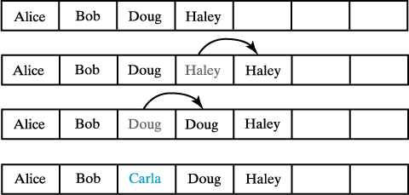
Adding Items in Mid-list
Making room to insert Carla as third entry in an array.

Slide 14
Add Method
public boolean add( T newEntry)
{
boolean isSuccessful = true;
if (!isFull())
{
list[length] = newEntry;
length++;
}
else
{
isSuccessful = false;
}
return isSuccessful;
}

Slide 15
Another Add Method
public boolean add( int newPosition, T newEntry)
{
boolean isSuccessful = true;
if (!isFull() && (newPosition >= 1) && (newPosition <= length +1) )
{
  makeRoom(newPosition);
  list[newPosition -1] = newEntry;
  length++;
}
else
{
isSuccessful = false;
}
return isSuccessful;
}

Slide 16
makeRoom Method
private void makeRoom( int newPosition)
{
assert (newPosition >=1) && (newPosition <= length +1);
int newIndex = newPosition -1;
int lastIndex = length -1;
// move each entry to higher next higher index starting at the end continuing
// until the entry at newIndex is moved
for ( int index = lastIndex; index >= newIndex; index--)
list[index +1] = list[index];
}

Slide 17
Questions?
1). Suppose that myList is a list that contains the five entries a b c d e.
a. what does myList contain after executing myList.add(5, w)?
b. Starting with the original five entries, what does myList contain after executing myList.add(6,w)?
c. Which of the operations in a and b of this question require elements in the array to shift?

Slide 18
Questions?
2). If myList is a list of five entries, each of the following statements adds a new entry to the end of the list:
myList.add(newEntry);
myList.add(6, newEntry);
Which way requires fewer operations?

Slide 19
The remove() Method
Must shift existing entries to avoid gap in the array
  Except when removing last entry
Method must also handle error situation
  When position specified in the remove is invalid
  When remove() is called and the list is empty
  Invalid call returns null value

Slide 20
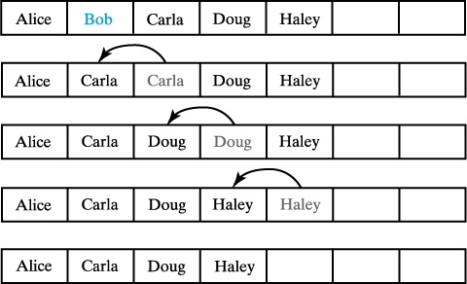
Removing a List Entry
Removing Bob by shifting array entries.

Slide 21
Remove Method
public T remove( int givenPosition)
{
T result = null; // return value
if ((givenPosition >= 1) && (givenPosition <= length))
{
assert !isEmpty();
result = list[givenPosition -1]; // get entry to be removed.
if (givenPosition < length)
// move subsequent entries toward entry to be removed unless it is last in list
removeGap(givenPostion);
length--;
}
// return reference to removed entry, or null if empty or givenPosition is invalid.
return result;
}

Slide 22
removeGap Method
private void removeGap( int givenPosition)
{
assert (givenPosition >= 1) && (givenPosition < length);
int removedIndex = givenPosition -1;
int lastIndex = length -1;
for ( int index = removedIndex; index < lastIndex; index++)
list[index] = list[index +1];
}
Question:
Previous remove figure shows Haley shifted toward the beginning of the array. Actually, the reference to Haley is copied, not moved, to its new location. Should we assign null to Haley’s original location?

Slide 23
Dynamic Array Expansion
An array has a fixed size
  If we need a larger list, we are in trouble
When array becomes full
  Move its contents to a larger array (dynamic expansion)
  Copy data from original to new location
  Manipulate names so new location keeps name of original array

Slide 24
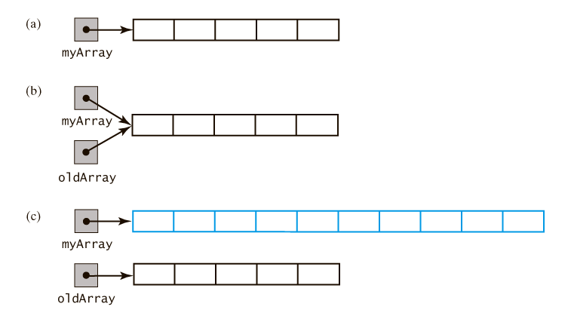
Dynamic Array Expansion
(a) an array;
(b) the same array with two references;
(c) the two arrays, reference to original array now
referencing a new, larger array

Slide 25

Dynamic Array Expansion
The dynamic expansion of an array copies the array's contents to a larger second array.

Slide 26
Dynamic Array Expansion
Let’s work with a simple array of integers:
int[] myArray = new int[INITIAL_SIZE];
// save reference to myArray
int[] oldArray = myArray;
// double the size of array
myArray = new int[2 * oldArray.length];
// copy the data from the old array to the new array
for ( int index = 0; index < oldArray.length; index++)
myArray[index] = oldArray[index];
//for a generic data type
private void doubleArray()
{
  T[] oldList = list;
  int oldSize = oldList.length;
  list = (T[]) new Object[2 * oldSize];
  for ( int index = 0; index < oldSize; index++)
  list[index] = oldList[index];
}

Slide 27
A New Implementation of a List
Change the isFull to always return false
  We will expand the array when it becomes full
  We keep this function so that the original interface does not change
The add() methods will double the size of the array when it becomes full
Now declare a private method isArrayFull
  Called by the add() methods

Slide 28
Using a Vector to Implement the ADT List
Java's Vector class provides capabilities of an array
  Able to expand dynamically
  Hides the details of the process
Vector
  Found in package java.util
  Has methods for manipulating entries
  Implementing the ADT List

Slide 29
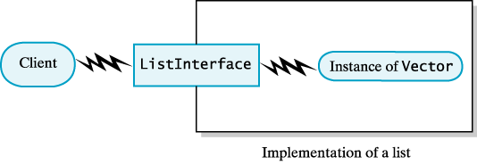
Using a Vector
A client uses the methods given in ListInterface, but the implementation of the list uses Vector methods to perform its operations

Slide 30
Using a Vector
Elements of the class
  Class Vector comes from package java.util
  Data field list is an instance of a Vector
  We can directly call Vector’s methods to implement the methods declared in the ListInterface.
import java.util.Vector;
public class VectorList<T> implements ListInterface
{
private Vector<T> list; // entries in list
. . .

Slide 31
Using a Vector
The add() methods
  The first uses the add method from the Vector class. list.add(newEntry);
  The other uses an overloaded add method. list.add(newPosition, newEntry);
The remove() method
  Uses the remove method.
    list.remove(givenPosition);

Slide 32
Pros and Cons of Array Use for the ADT List
When using an array or vector …
  Retrieving an entry is fast
  Adding an entry at the end of the list is fast
  Adding or removing an entry that is between other entries requires shifting elements in the array
  Increasing the size of the array or vector requires copying elements

Slide 33
Java Class Library
Has a class similar to class AList defined in this chapter
  Class ArrayList
  Uses dynamic array expansion

